Slide 1
Chapter 1 Introduction to Computers, Programs, and Python

Slide 2
Objectives
To understand computer basics.
Learn about programming languages
To understand how a Program Works
To understand how Computers Store Data
Examine high-level programming languages
Discover what a compiler is and what it does
To learn how to use Python IDLE

Slide 3
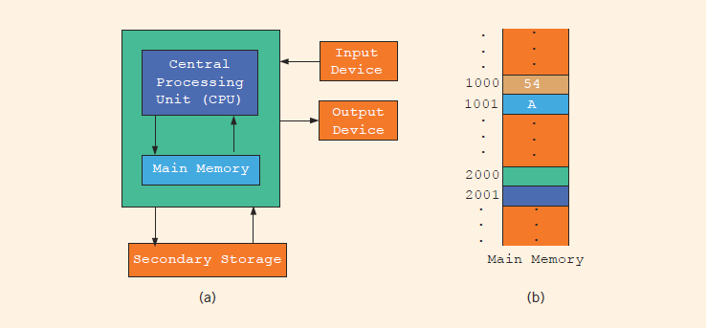
What is a Computer?
Central processing unit (CPU)
Main memory (RAM)
Secondary storage
Input/output devices

Slide 4
Central Processing Unit (CPU)
The central processing unit (CPU) is the brain of a computer. It retrieves instructions from memory and executes them.

Slide 5
Main Memory (RAM)
Memory is to store data and program instructions for CPU to execute. A memory unit is an ordered sequence of bytes, each holds eight bits. A program and its data must be brought to memory before they can be executed. When computer power is turned off, everything in main memory is lost.

Slide 6
Secondary Storage
Programs and data are permanently stored on storage devices and are moved to memory when the computer uses them. Examples of secondary storage Hard disks, Flash drives, and CD-ROMs

Slide 7
Input/Output Devices
Input devices - feed data and programs into computers. Examples:
Keyboard, Mouse, Scanner, Camera, and Secondary storage.
Output devices - display results. Examples: monitor, printer, and Secondary storage

Slide 8
Programs
Computer programs, known as software, are instructions to the computer.
You tell a computer what to do through programs. Without programs, a computer is an empty machine. Computers do not understand human languages, so you need to use computer languages to communicate with them.
Programs are written using programming languages.

Slide 9
Programming Languages
Machine Language Assembly Language High-Level Language
Machine language is the language of a computer. It is a sequence of 0s and 1s. The digit 0 or 1 is called a binary digit.
Early computers were programmed in machine language.
To calculate wages = rate * hours in machine language:
100100 010001 //Load
100110 010010 //Multiply
100010 010011 //Store

Slide 10
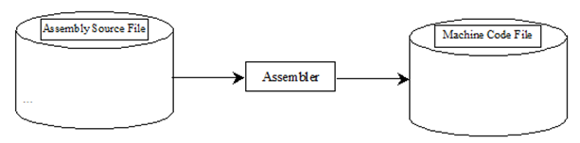
Programming Languages
Machine Language Assembly Language High-Level Language
Assembly languages were developed to make programming easy.
Since the computer cannot understand assembly language, a program called assembler is used to convert assembly language programs into machine code.
Using assembly language instructions, wages = rate * hours can be written as:
LOAD rate
MULT hours
STOR wages

Slide 11
Programming Languages
Machine Language Assembly Language High-Level Language
The high-level languages are English-like and easy to learn and program.
For example, the following is a high-level language statement that computes the wages:
wages = rate * hours;

Slide 12
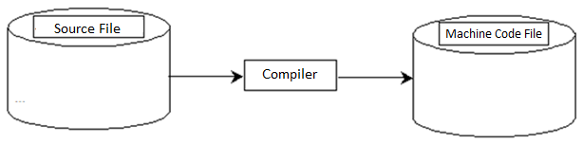
Compiling Source Code
A program written in a high-level language is called a source program.
Since a computer cannot understand a source program, a program called a compiler is used to translate the source program into a machine language program.

Slide 13
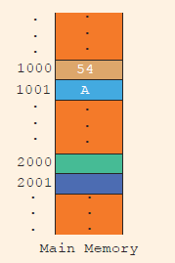
How is Data Stored?
Data of various kinds, such as numbers, characters, and strings, are encoded as a series of bits (zeros and ones).
The programmers need not to be concerned about the encoding and decoding of data, which is performed automatically by the system based on the encoding scheme.
For example,
A is encoded as 1000001
The character 3 is encoded as 0110011

Slide 14
Storing Characters
Most important coding scheme is ASCII
ASCII is limited: defines codes for only 128 characters
Unicode coding scheme becoming standard
Compatible with ASCII
Can represent characters for other languages

Slide 15
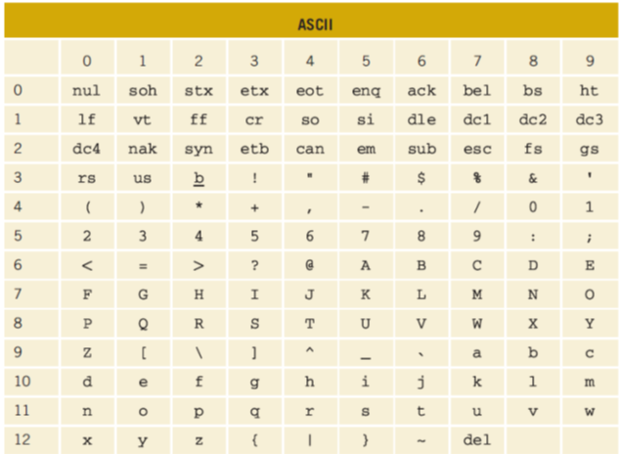
ASCII Character Set

Slide 16
Popular High-Level Languages
Java (Java is a general-purpose programming language)
Visual Basic (Basic-like visual language developed by Microsoft)
C++ (an object-oriented language, based on C)
C# (a Python-like language developed by Microsoft)
Python (We use it in the book)

Slide 17
What is Python?
General Purpose Interpreted Object-Oriented
Python is a general-purpose programming language. That means you can use Python to write code for any programming tasks.
Python are now used in Google search engine, in mission critical projects in NASA, in processing financial transactions at New York Stock Exchange.

Slide 18
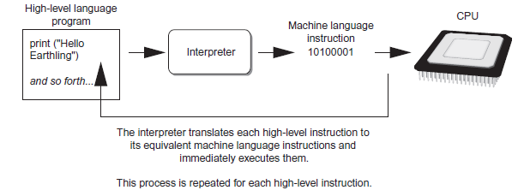
What is Python?
General Purpose Interpreted Object-Oriented
Python is interpreted, which means that python code is translated and executed by an interpreter one statement at a time.
In a compiled language, the entire source code is compiled and then executed altogether.

Slide 19
What is Python?
General Purpose Interpreted Object-Oriented
Python is an object-oriented programming language.
Data in Python are objects created from classes. A class is essentially a type that defines the objects of the same kind with properties and methods for manipulating objects.
Object-oriented programming is a powerful tool for developing reusable software.

Slide 20
Python Interpreter
Python must be installed and configured prior to use.
One of the items installed is the Python interpreter
Python interpreter can be used in two modes:
Interactive mode: enter statements on keyboard
Script mode: save statements in Python script

Slide 21
Python Interactive Mode
When you start Python in interactive mode, you will see a prompt
Indicates the interpreter is waiting for a Python statement to be typed
Error message displayed If you incorrectly type a statement
Good way to learn new parts of Python

Slide 22
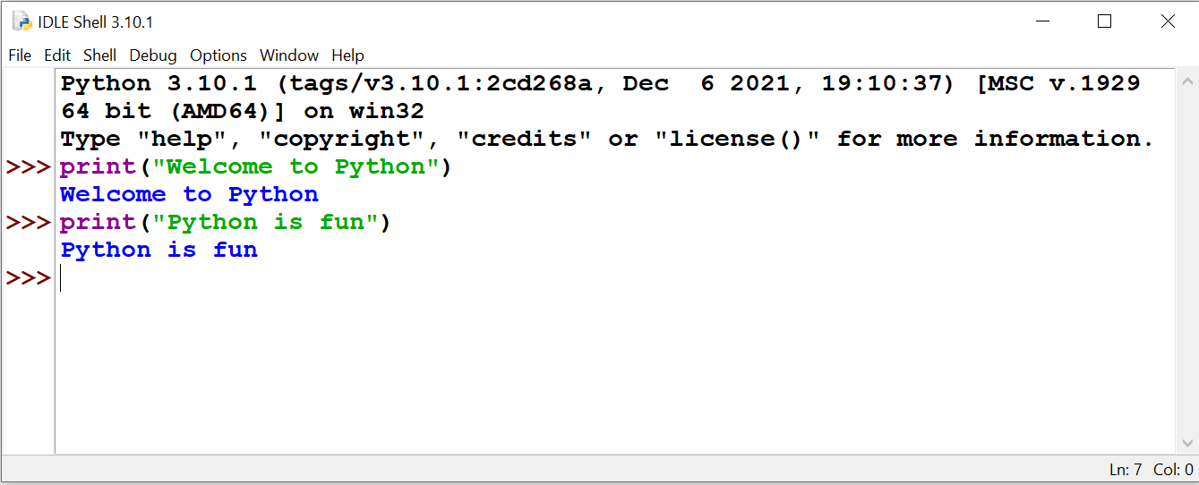
Python Interactive Mode

Slide 23
Python Script Mode
Statements entered in interactive mode are not saved as a program
To have a program use script mode
Save a set of Python statements in a file
The filename should have the .py extension
To run the file, or script, type
load - run

Slide 24
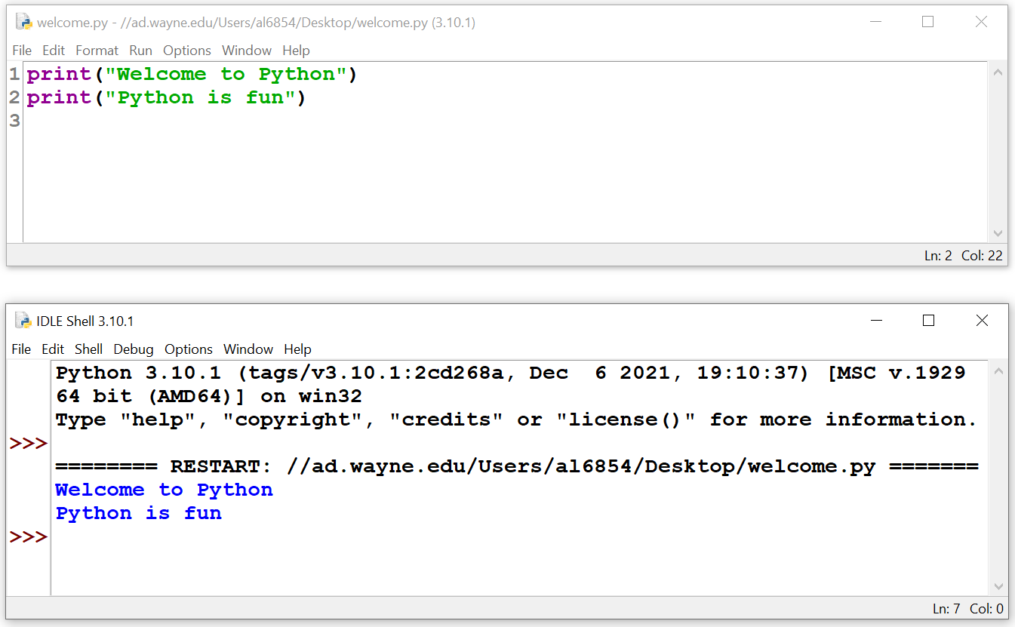
Python Script Mode

